Slide 1
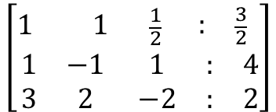
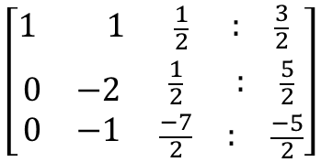
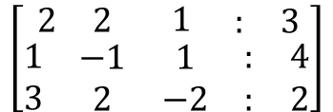

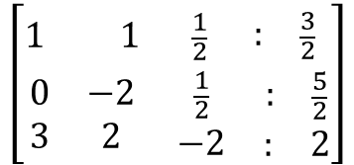

$$\left[\begin{matrix}\begin{matrix}2 & 2\end{matrix} & \begin{matrix}1 & \begin{matrix}: & 3\end{matrix}\end{matrix} \\ \begin{matrix}\begin{matrix}1 \\ 3\end{matrix} & \begin{matrix}−1 \\ 2\end{matrix}\end{matrix} & \begin{matrix}\begin{matrix}1 \\ −2\end{matrix} & \begin{matrix}\begin{matrix}: & 4\end{matrix} \\ \begin{matrix}: & 2\end{matrix}\end{matrix}\end{matrix}\end{matrix}\right]$$
Kita mulai membentuk matriks segitiga atas
½ *Baris 1
$$\left[\begin{matrix}1 1 & \begin{matrix}\frac{1}{2} & \begin{matrix}: & \frac{3}{2}\end{matrix}\end{matrix} \\ \begin{matrix}\begin{matrix}1 \\ 3\end{matrix} & \begin{matrix}−1 \\ 2\end{matrix}\end{matrix} & \begin{matrix}\begin{matrix}1 \\ −2\end{matrix} & \begin{matrix}\begin{matrix}: & 4\end{matrix} \\ \begin{matrix}: & 2\end{matrix}\end{matrix}\end{matrix}\end{matrix}\right]$$
$$\left[\begin{matrix}1 1 & \begin{matrix}\frac{1}{2} & \begin{matrix}: & \frac{3}{2}\end{matrix}\end{matrix} \\ \begin{matrix}\begin{matrix}0 \\ 3\end{matrix} & \begin{matrix}−2 \\ 2\end{matrix}\end{matrix} & \begin{matrix}\begin{matrix}\frac{1}{2} \\ −2\end{matrix} & \begin{matrix}\begin{matrix}: & \frac{5}{2}\end{matrix} \\ \begin{matrix}: & 2\end{matrix}\end{matrix}\end{matrix}\end{matrix}\right]$$
($B_{2}$- $B_{1}$) ~
$$\left[\begin{matrix}1 1 & \begin{matrix}\frac{1}{2} & \begin{matrix}: & \frac{3}{2}\end{matrix}\end{matrix} \\ \begin{matrix}\begin{matrix}0 \\ 0\end{matrix} & \begin{matrix}−2 \\ −1\end{matrix}\end{matrix} & \begin{matrix}\begin{matrix}\frac{1}{2} \\ \frac{−7}{2}\end{matrix} & \begin{matrix}\begin{matrix}: & \frac{5}{2}\end{matrix} \\ \begin{matrix}: & \frac{−5}{2}\end{matrix}\end{matrix}\end{matrix}\end{matrix}\right]$$
($B_{3}$- 3*$B_{1}$) ~

Slide 2

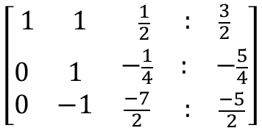
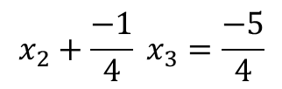




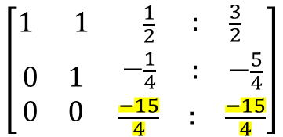
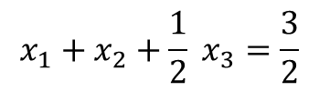
$$\left[\begin{matrix}1 1 & \begin{matrix}\frac{1}{2} & \begin{matrix}: & \frac{3}{2}\end{matrix}\end{matrix} \\ \begin{matrix}\begin{matrix}0 \\ 0\end{matrix} & \begin{matrix}1 \\ −1\end{matrix}\end{matrix} & \begin{matrix}\begin{matrix}−\frac{1}{4} \\ \frac{−7}{2}\end{matrix} & \begin{matrix}\begin{matrix}: & −\frac{5}{4}\end{matrix} \\ \begin{matrix}: & \frac{−5}{2}\end{matrix}\end{matrix}\end{matrix}\end{matrix}\right]$$
(-½) *Baris 2
$$\left[\begin{matrix}1 1 & \begin{matrix}\frac{1}{2} & \begin{matrix}: & \frac{3}{2}\end{matrix}\end{matrix} \\ \begin{matrix}\begin{matrix}0 \\ 0\end{matrix} & \begin{matrix}1 \\ 0\end{matrix}\end{matrix} & \begin{matrix}\begin{matrix}−\frac{1}{4} \\ \frac{−15}{4}\end{matrix} & \begin{matrix}\begin{matrix}: & −\frac{5}{4}\end{matrix} \\ \begin{matrix}: & \frac{−15}{4}\end{matrix}\end{matrix}\end{matrix}\end{matrix}\right]$$
Sudah terbentuk matriks segitiga atas
($B_{3}$+ $B_{2}$) ~
Dari baris ke 3 terlihat bahwa :
$\frac{−15}{4}$ $x_{3}=\frac{−15}{4}$
$$x_{3}=1$$
$$x_{2}+\frac{−1}{4} x_{3}=\frac{−5}{4}$$
Kemudian kita naik ke baris ke 2:
$x_{2}=\frac{−5}{4}$ $+\frac{1}{4} \left(1\right)=\frac{−4}{4}$ =-1
$${x_{1}+x}_{2}+\frac{1}{2} x_{3}=\frac{3}{2}$$
Kemudian kita naik ke baris ke 1:
$x_{1}=\frac{3}{2}$ ${−x}_{2}−\frac{1}{2} x_{3}$ = $\frac{3}{2}$ $+1−\frac{1}{2} (1)=\frac{4}{2}$ =2

Slide 3
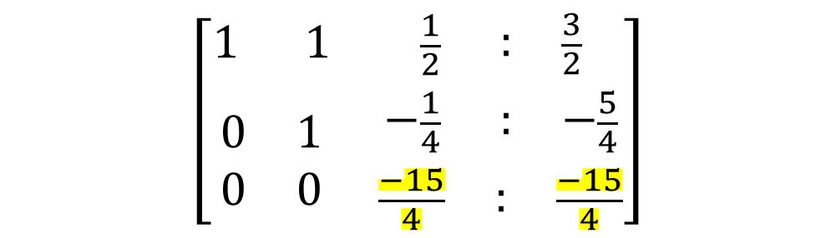
$$\left[\begin{matrix}1 1 & \begin{matrix}\frac{1}{2} & \begin{matrix}: & \frac{3}{2}\end{matrix}\end{matrix} \\ \begin{matrix}\begin{matrix}0 \\ 0\end{matrix} & \begin{matrix}1 \\ 0\end{matrix}\end{matrix} & \begin{matrix}\begin{matrix}−\frac{1}{4} \\ \frac{−15}{4}\end{matrix} & \begin{matrix}\begin{matrix}: & −\frac{5}{4}\end{matrix} \\ \begin{matrix}: & \frac{−15}{4}\end{matrix}\end{matrix}\end{matrix}\end{matrix}\right]$$
-15/4 x3 = -15/4
x3 = 1
X2 -1/4 x3 = -5/4
X2 = -5/4 + ¼ (1)
X2 = -1
X1 + x2 + ½ x3 = 3/2
X1 -1 + ½ (1) = 3/2
X1 = 2

Slide 4
CEK HASIL GAUSS NAIF
2 x1 + 2x2 +x3 =3
2(2) + 2 (-1) + 1 = 3

